Slide 1


SNO Single Node OpenShift
Glenn West
gwest@redhat.com

Slide 2
Prereqs
DNS Entries
Bios
DHCP
Disk / ISO

Slide 3
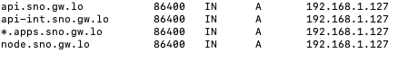
DNS Setup
4 entries
Api internal, api external
Node entry
App wildcard

Slide 4
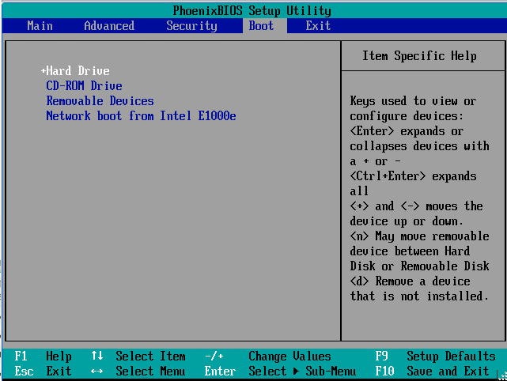
BIOS Settings

Slide 5
Disk and ISO
Drive should be erased
Use the online assisted installer to configure and create discovery iso
Download to where you can use the iso for ipmi or vm

Slide 6
Assisted Installer
Used Online at: https://cloud.redhat.com/openshift/assisted-installer/clusters/
Can also be used via api see: https://github.com/openshift/assisted-service/blob/master/docs/cloud.md
Can also be run locally
Current Version for ocp sno is 4.8.0.fc3

Slide 7
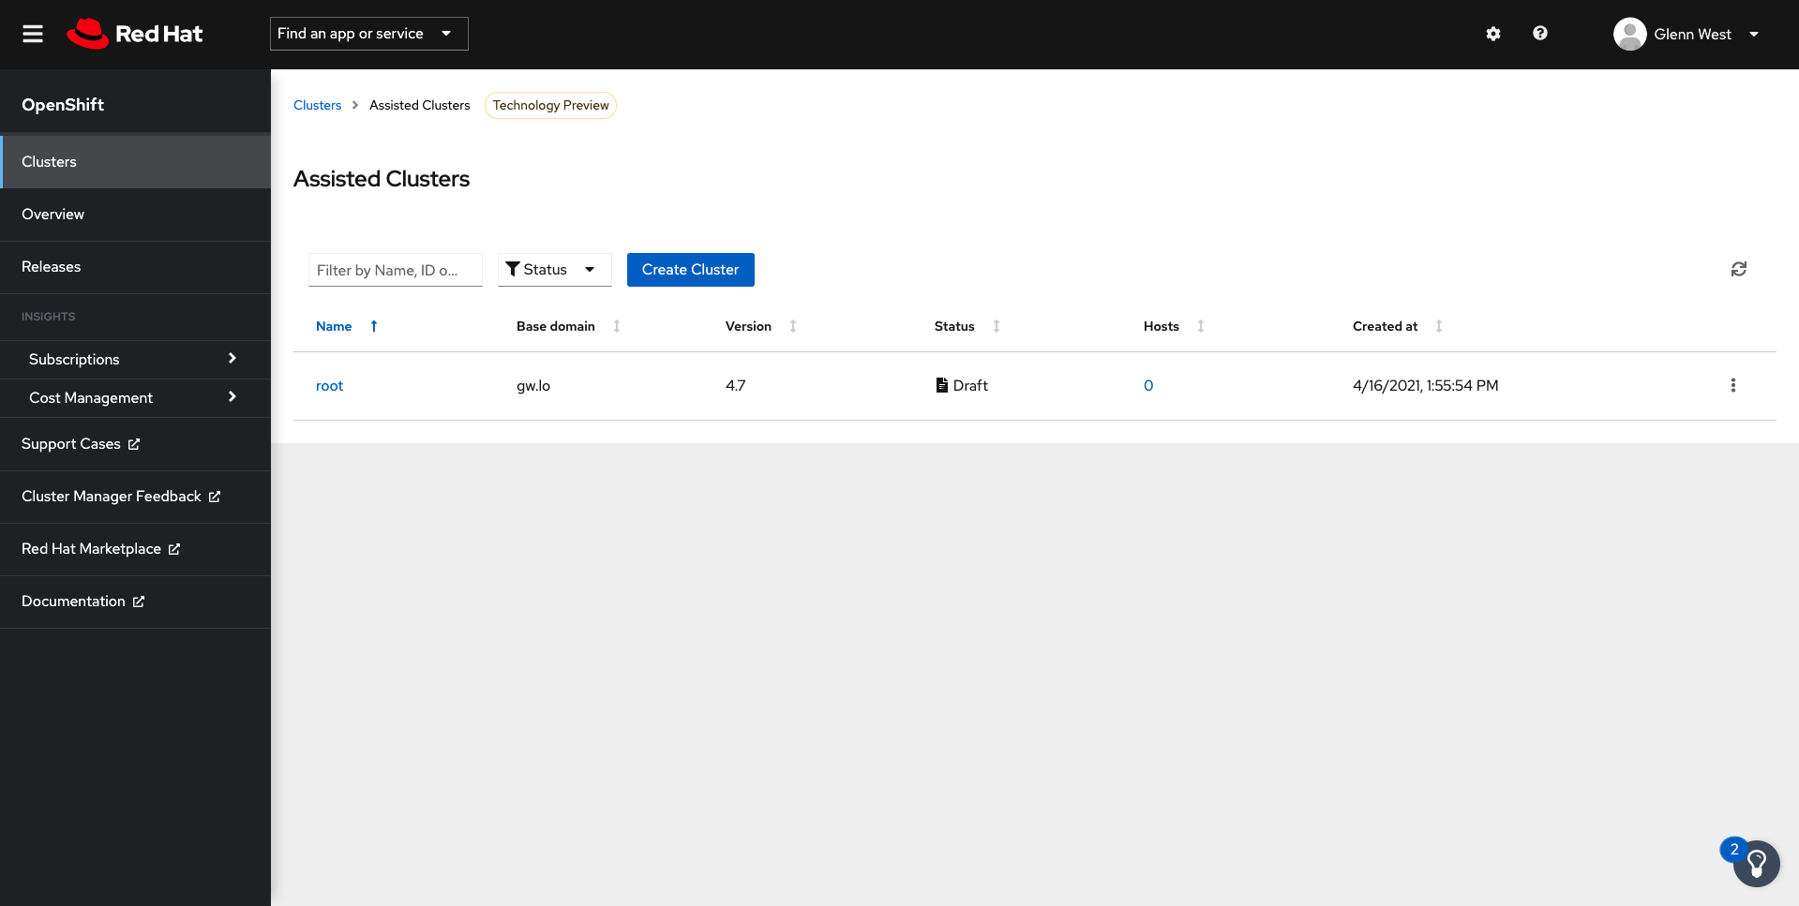
Assisted Installer

Slide 8
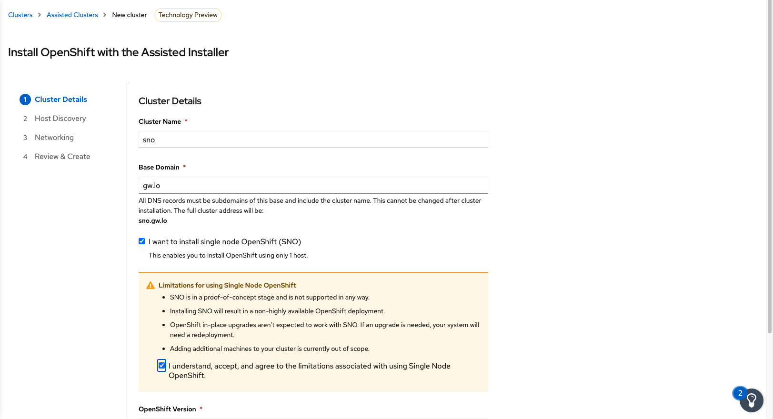
Create New Cluster

Slide 9
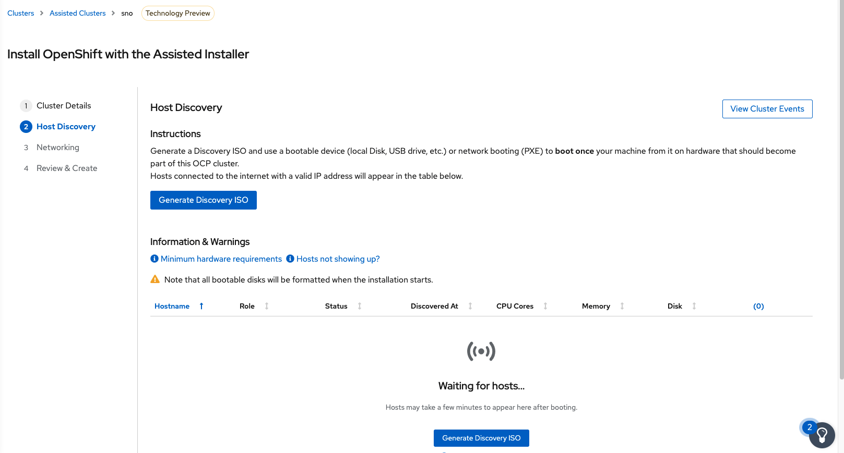
Create the Discovery ISO

Slide 10
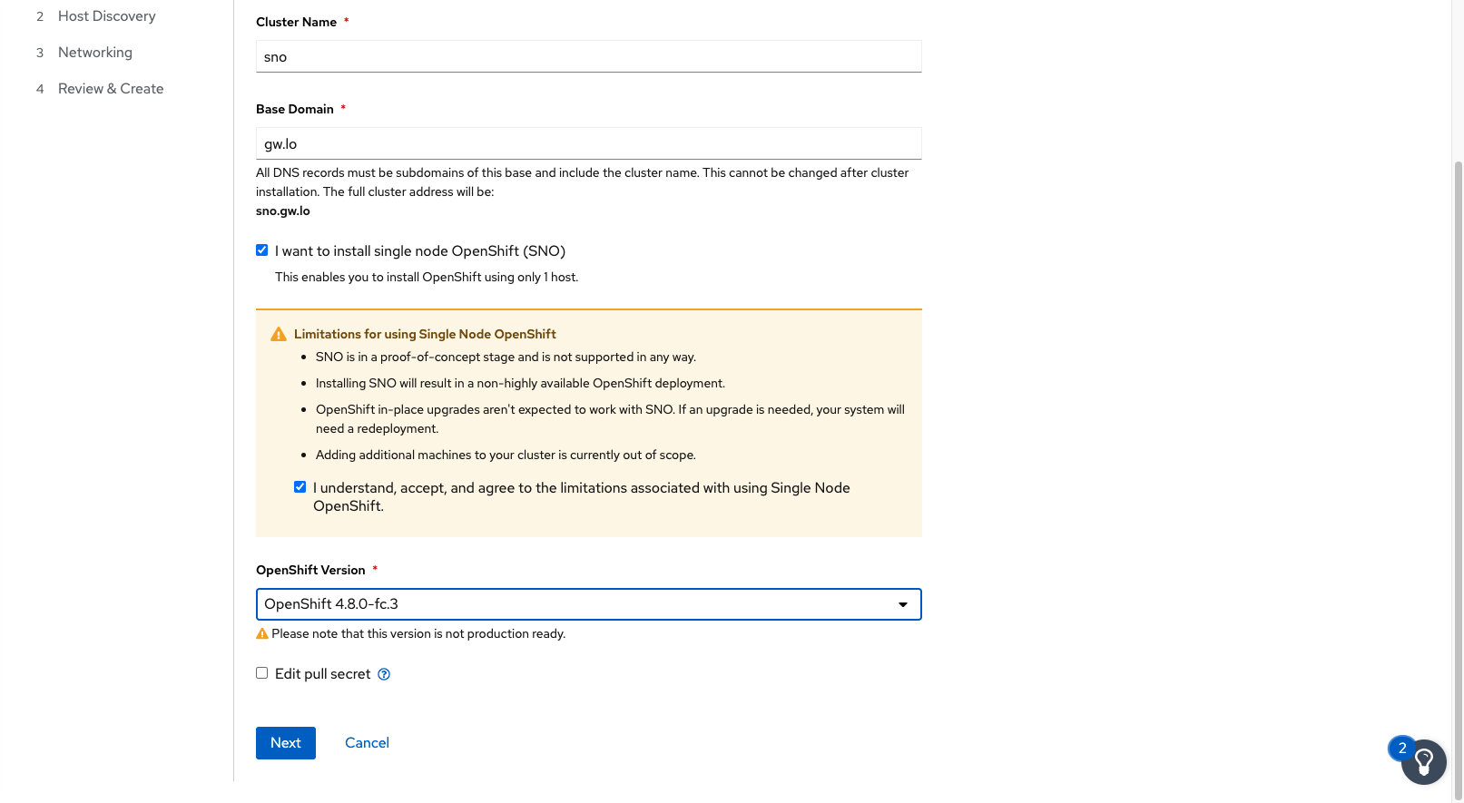
Select sno and version

Slide 11
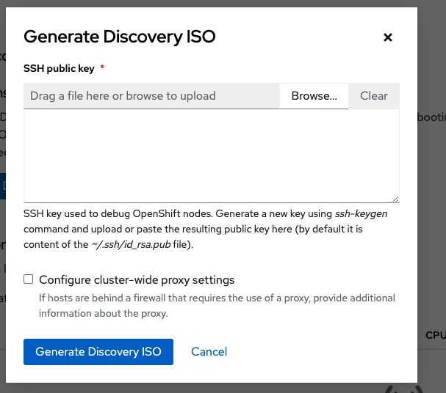
Start the iso generation

Slide 12
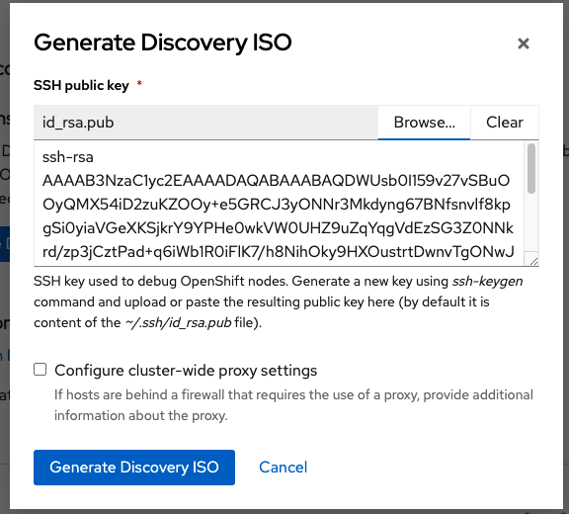
Add in your ssh key

Slide 13
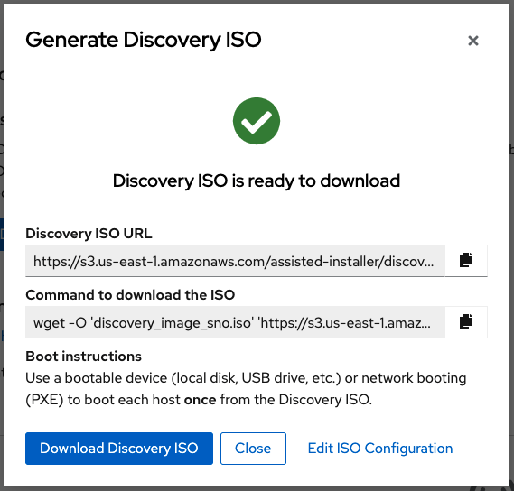
Download the iso to where you can use it

Slide 14
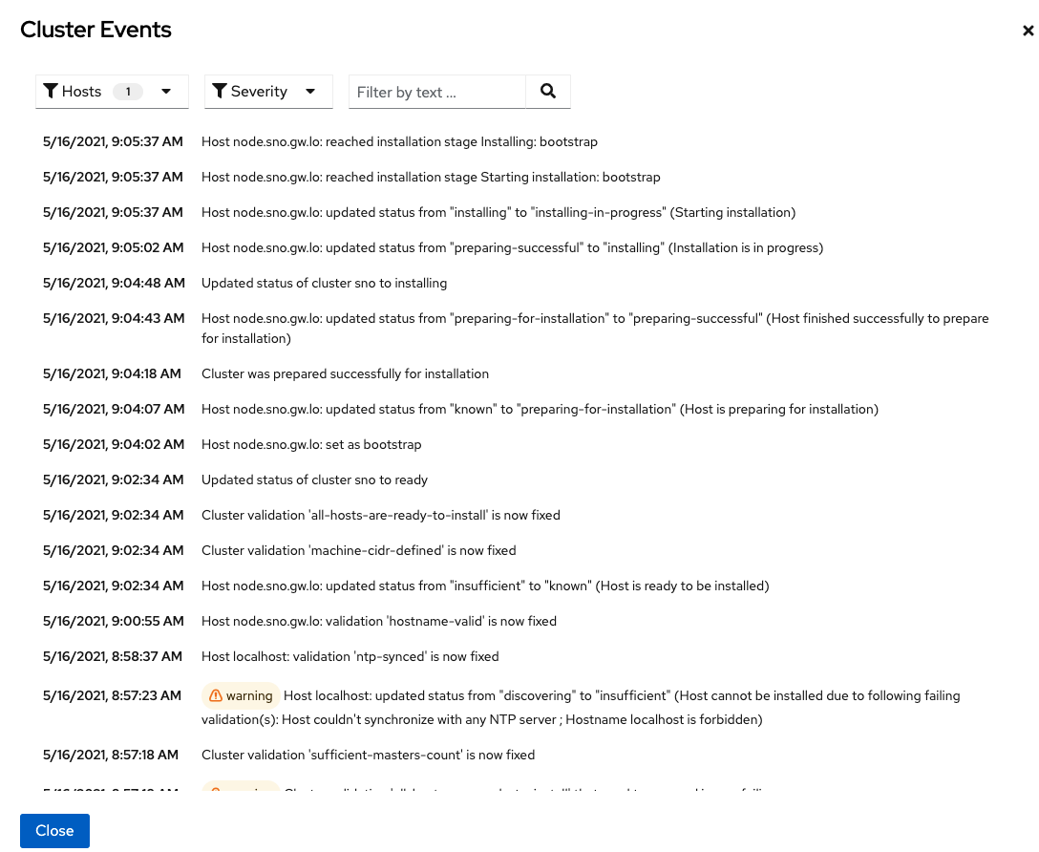

Slide 15
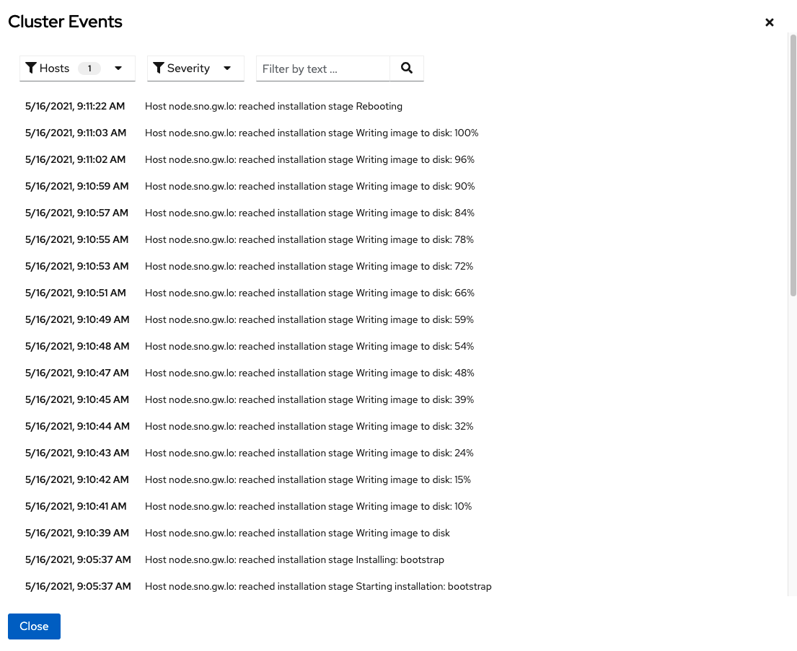

Slide 16
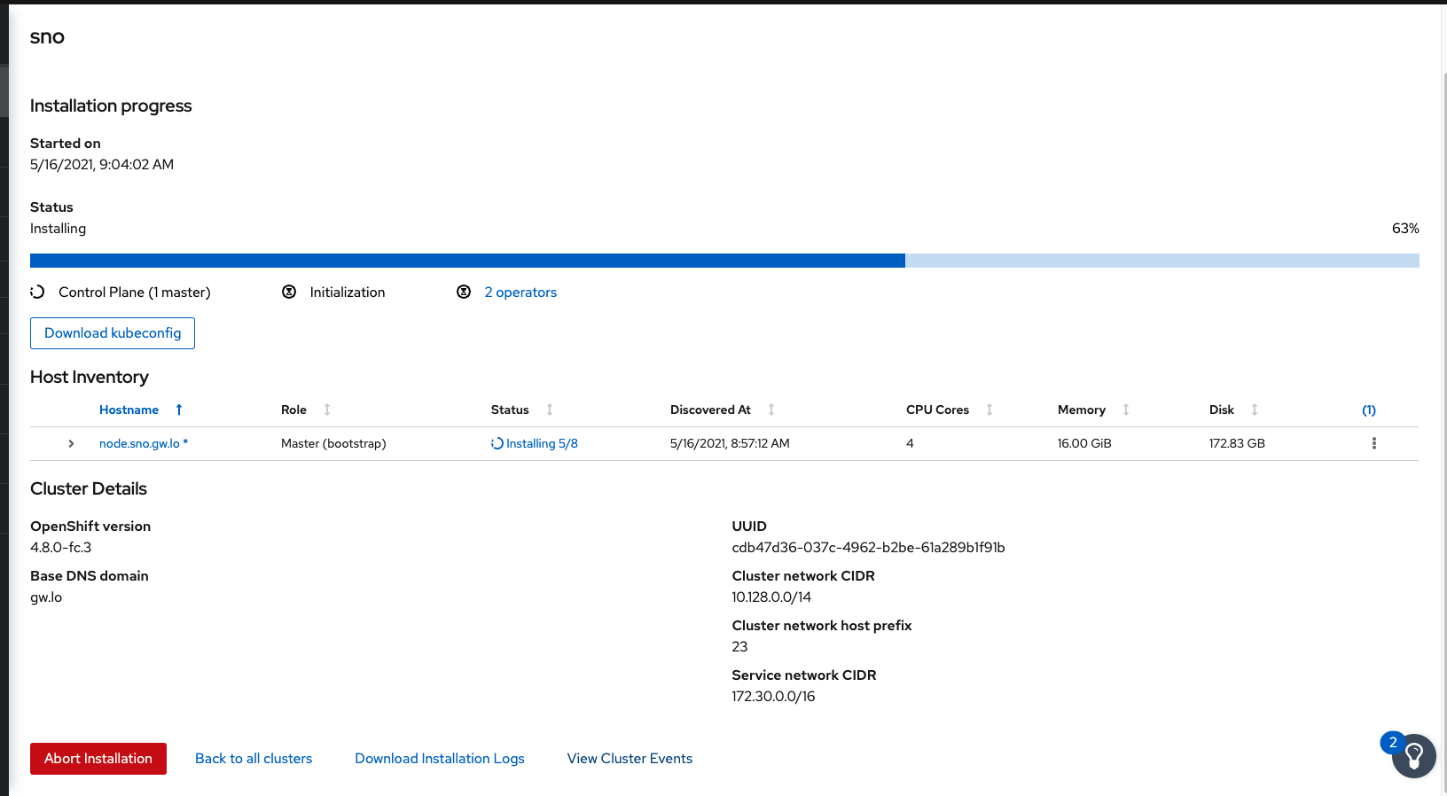

Slide 17
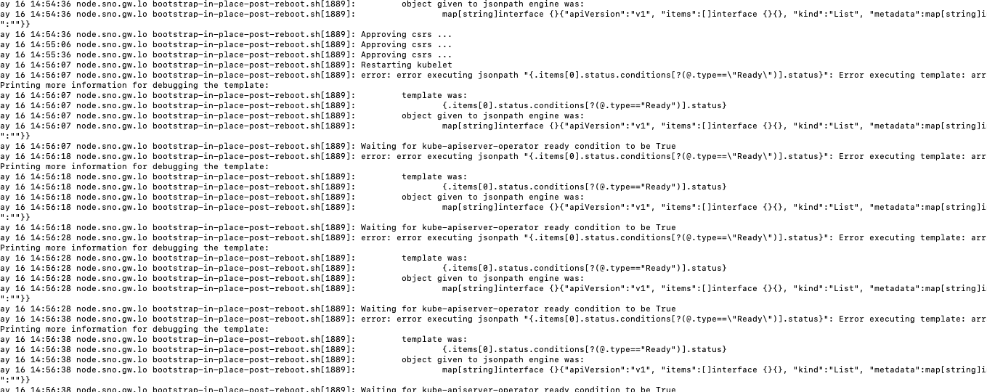

Slide 18
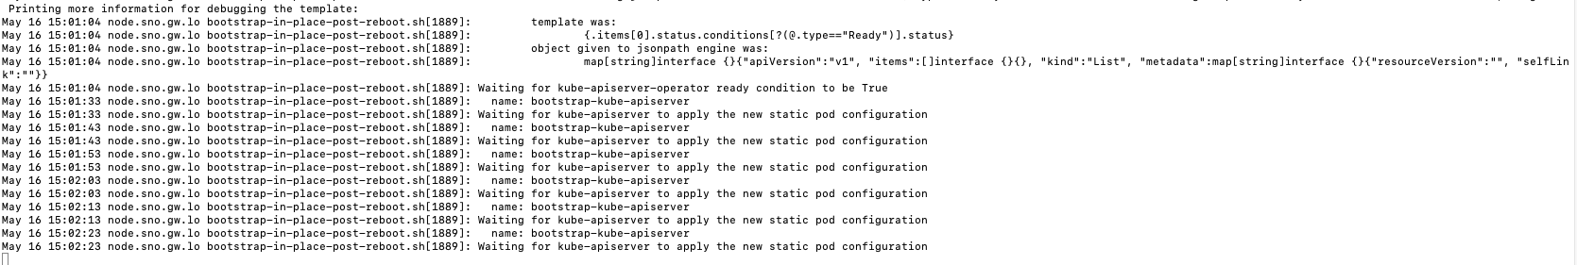

Slide 19
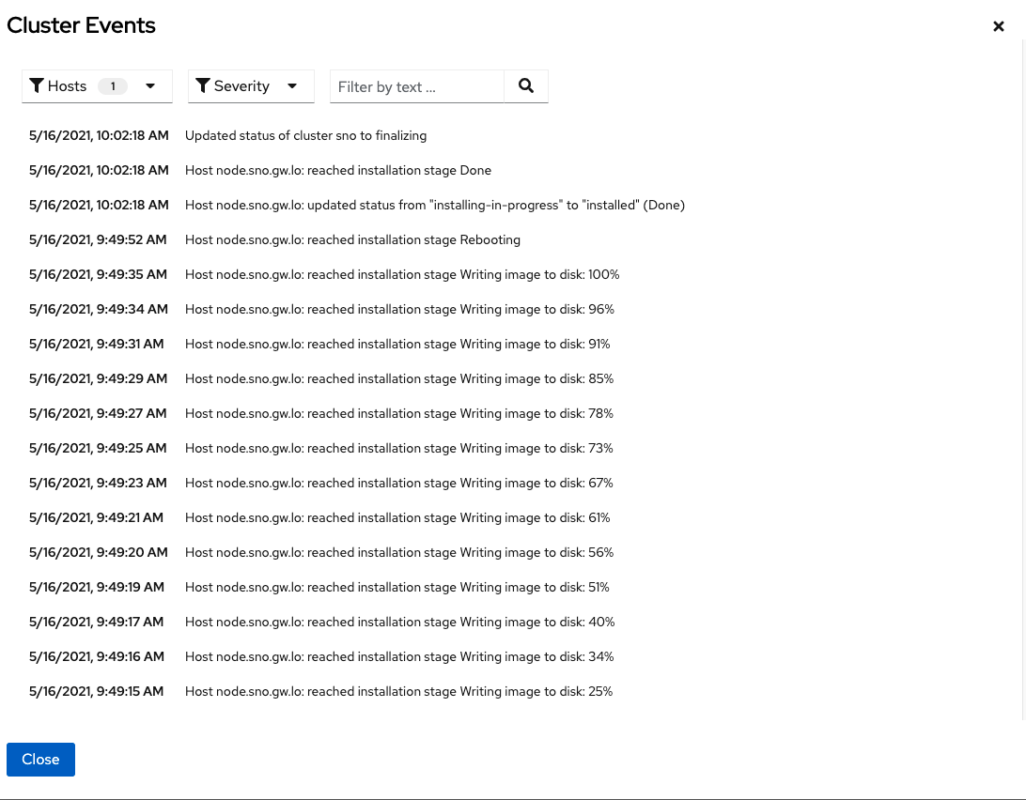

Slide 20
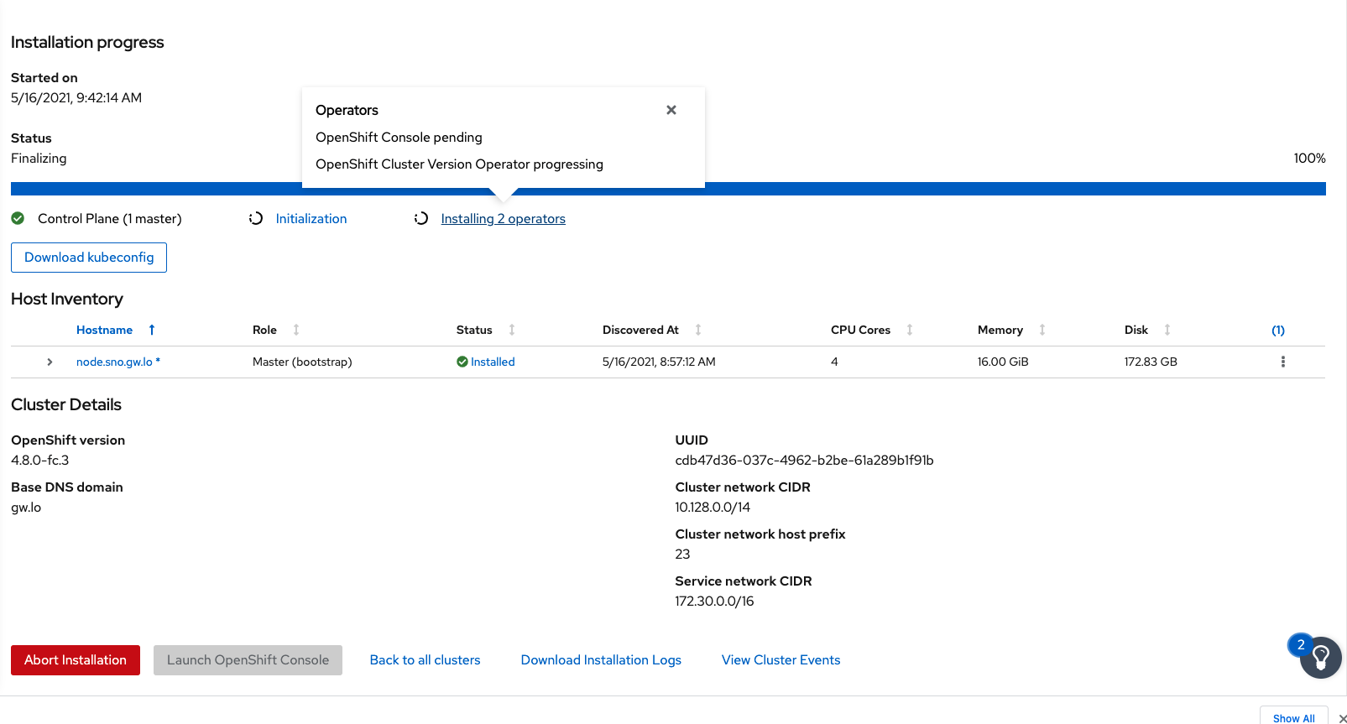

Slide 21
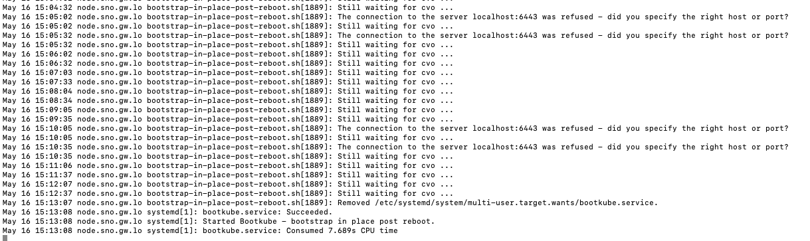

Slide 22
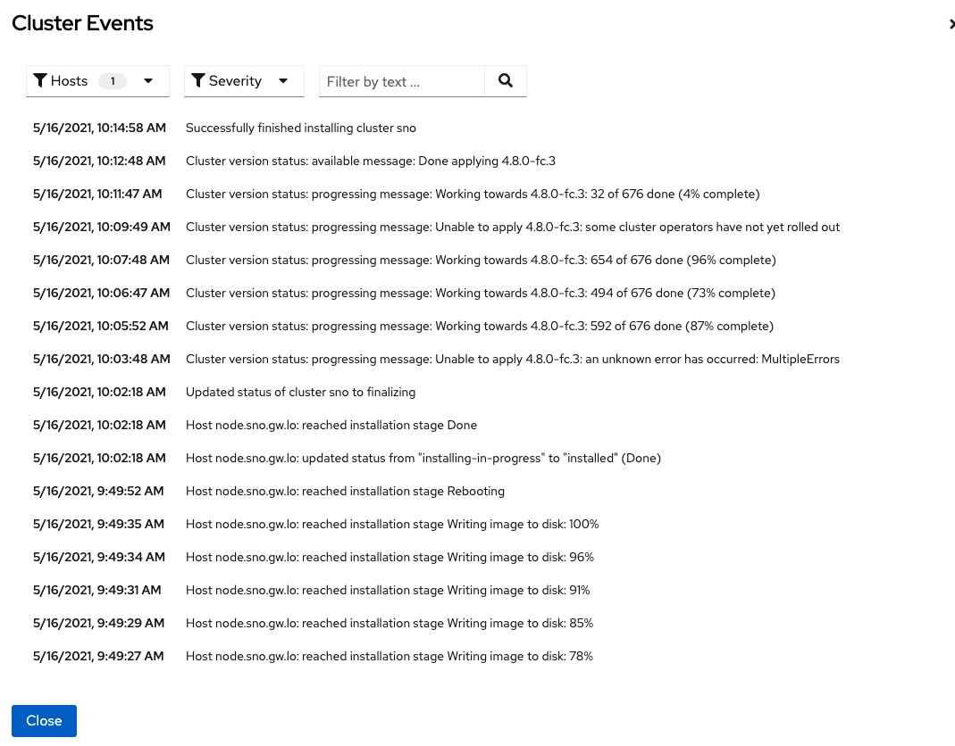

Slide 23
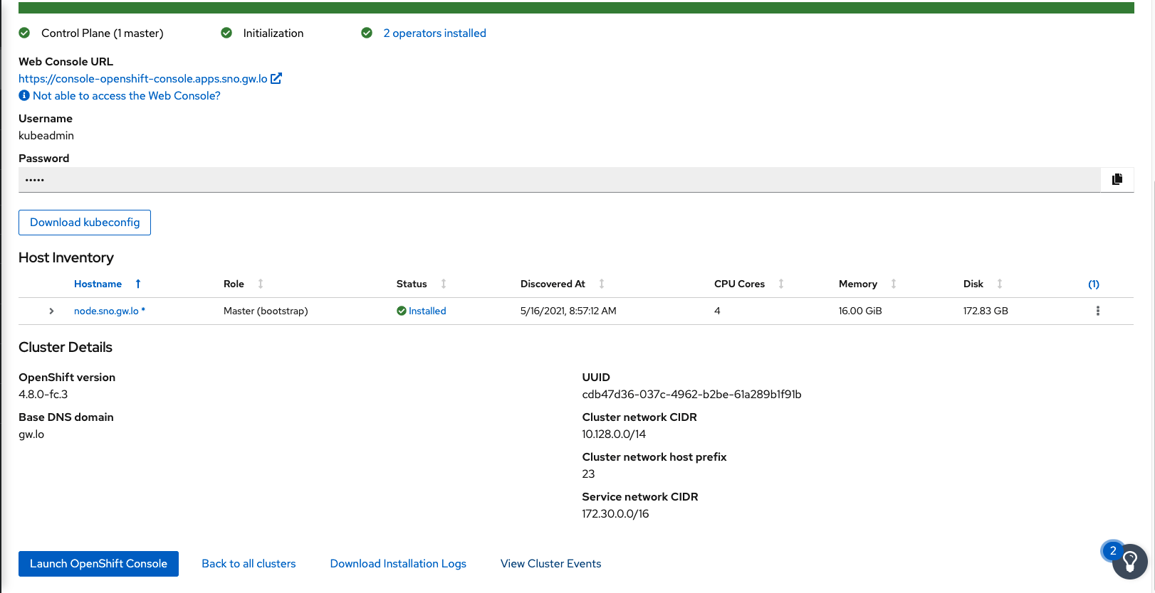

Slide 24
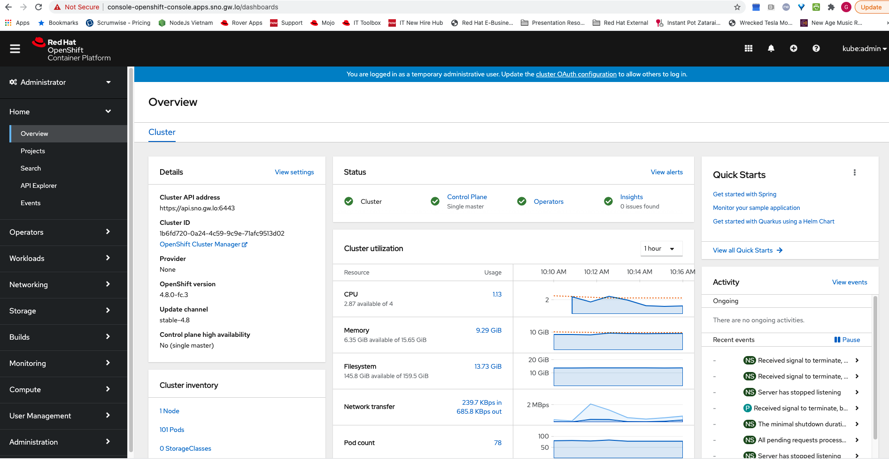

Slide 25
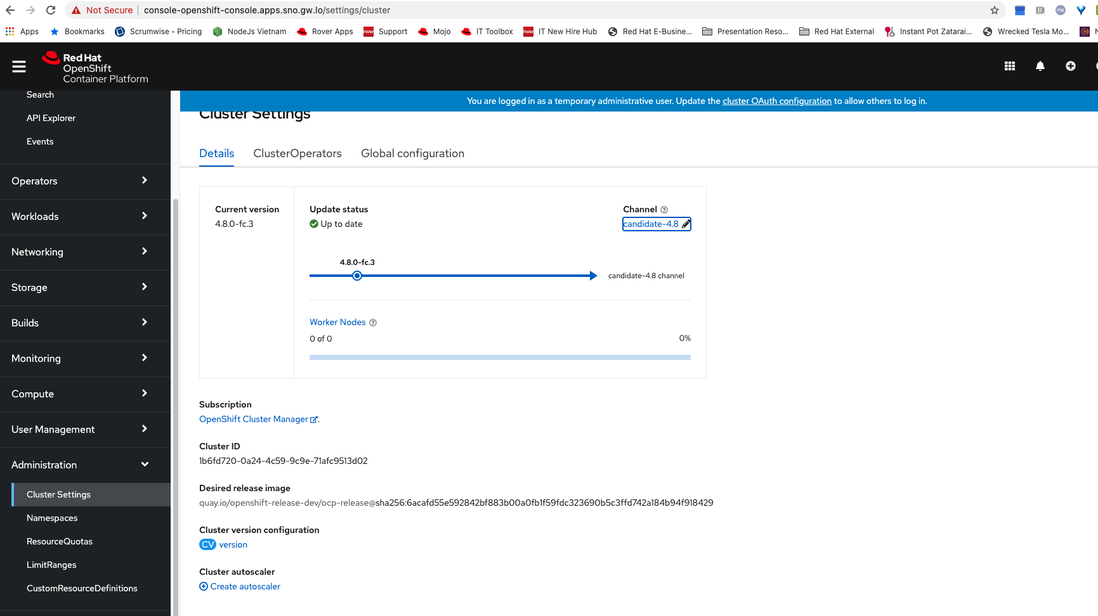

Slide 26
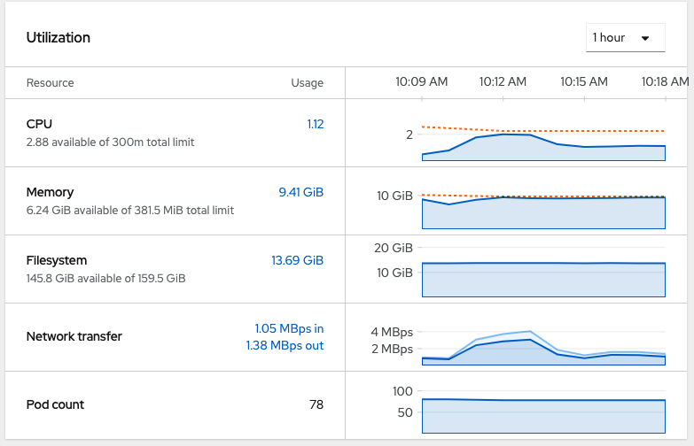

Slide 27
Timing
6 minutes for writing imaging to disk
12 minutes in rebooting phase
33 minutes total for install

Slide 28
Issues
Boot order is important, install will fail otherwise
DHCP may not set the host name, and install will fail. (Seen it once on creating slides)
Ssh will fail if hostname is not set

